Slide 1

DFS Lineup Optimizer January 23, 2018
Project Release Plan
Product Name: QuickPick
Team members:
Product owner: Gautam Sarkar
Initial scrum master: Joelle Steichen
Ben Sherriff
Nagie Khant
Joey Casteloes
Edmund Yu

Slide 2
DFS Lineup Optimizer
Project Release Plan
A lot of DFS Lineup Optimizers require users to pay and our DFS Lineup Optimizer provides a free desktop application alternative
High-Level Goals:
Be able to produce optimized lineups for Daily Fantasy Sports
Be able to create lineup constraints for all usual settings present in DFS Optimizers
Be able to create non-trivial settings based on user’s own insights
Be able to import user’s data without wrangling it to fit with the optimizer’s header columns
Be able to export user data easily inside the GUI tool
Initial platform will be Windows

Slide 3
DFS Lineup Optimizer
Project Release Plan – User Stories
Sprint 1 user stories
User Stories | High-Level Goal
As a new user I want an intuitive GUI so I don't have to spend time learning a new tool Have a functional, easy-to-use user interface) | Have a functional, easy-to-use user interface Will be easily able to use for product testing
As a person on the move, I want a non internet based tool so I can use it wherever I am | Initial platform will be Windows compatible
As a DFS player I want a ‘constraint’ for the number of players selected so I can output actual lineups | Be able to create lineup constraints for all usual settings present in DFS Optimizers
As a DFS player I want a ‘constraint’ for the sum of a column so I can limit the total cost of my team | Be able to create lineup constraints for all usual settings present in DFS Optimizers

Slide 4
DFS Lineup Optimizer
Project Release Plan – User Stories
Sprint 2 user stories
User Stories | High-Level Goal
As a DFS player I want a ‘constraint’ for the number of unique values(really strings) in each column so I can limit the number of players in each position/team | Be able to create lineup constraints for all usual settings present in DFS Optimizers Be able to create non-trivial constraints based on user’s own insights
As a DFS player I want a to choose the number of lineups output so I hedge/consolidate my risks | Be able to create lineup constraints for all usual settings present in DFS Optimizers
As a DFS player, I want an export to csv so all I don’t have to spend time manually doing it myself | Be able to produce optimized lineups
As a DFS player I want savable configurations so I can easily use it multiple times | Be able to create lineup constraints for all usual settings present in DFS Optimizers

Slide 5
DFS Lineup Optimizer
Project Release Plan – User Stories
Sprint 3 user stories each labeled with associated high-level goal
User Stories | High-Level Goal
As a DFS player I want a large amount of possible ‘constraints’(5+) so I can just plug in my data without modifying it and without | Be able to create non-trivial constraints based on user’s own insights
As a DFS player I want a ‘constraint’ for the number of times a certain row#(player) is selected so I can hedge/consolidate my risks | Be able to create lineup constraints for all usual settings present in DFS Optimizers
As a DFS player I want preloaded configurations for different sports/DFS providers so I can quickly modify and use the tool | Be able to create lineup constraints for all usual settings present in DFS Optimizers

Slide 6
DFS Lineup Optimizer
Project Release Plan – Architecture
The GUI allows the user to specify the input CSV file’s location and to change settings called ‘constraints’ that are stored in a text file.
The Optimizer reads the raw csv file and the ‘constraints’ file and outputs a temporary csv file with the lineup information.
The GUI then reads the temporary CSV file and displays the results.
There is an export feature in the GUI that would move the temporary file into a permanent location.

Slide 7
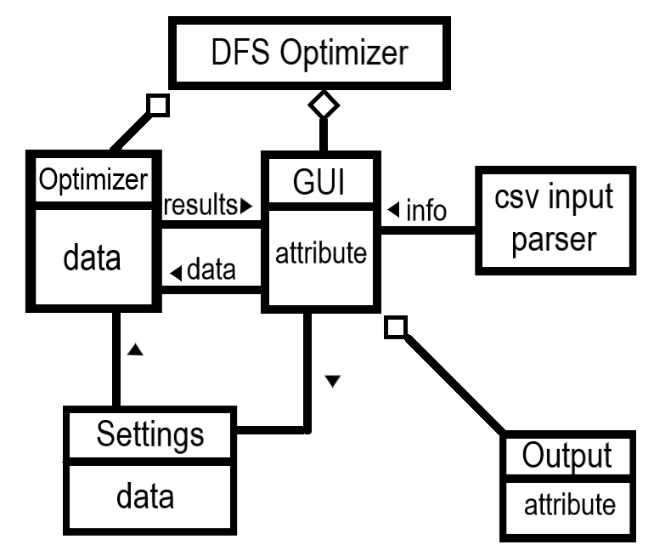
Project Release Plan – Architecture

Slide 8
DFS Lineup Optimizer
Project Release Plan – Challenges/Risks
Challenge/Risk 1
Have to figure out what Python library to use for GUI
For those who don’t know the language and/or framework, they will have to learn
Challenge/Risk 2
Figure out how to pass information from GUI
Challenge/Risk 3
Python not being on lab computers(will use an executable)
…

Slide 9
DFS Lineup Optimizer
Project Release Plan – Technologies
Technology 1 (programming language(s))
Python 3
Technology 2 (libraries)
Pulp
Pandas
Tkinter
cx_Freeze

